Slide 1
Discussion Topic
Battery Charger

Slide 2
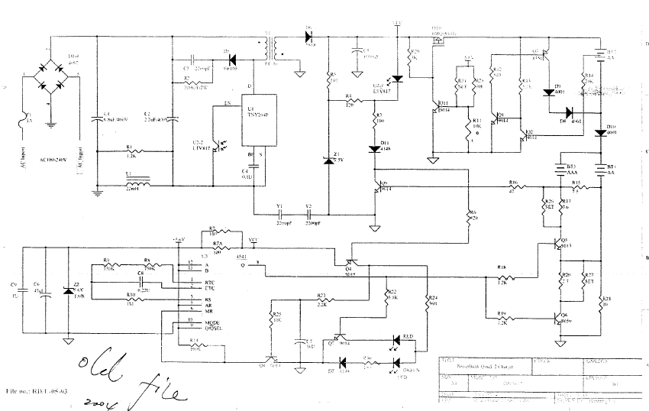
Circuit Diagram 1

Slide 3
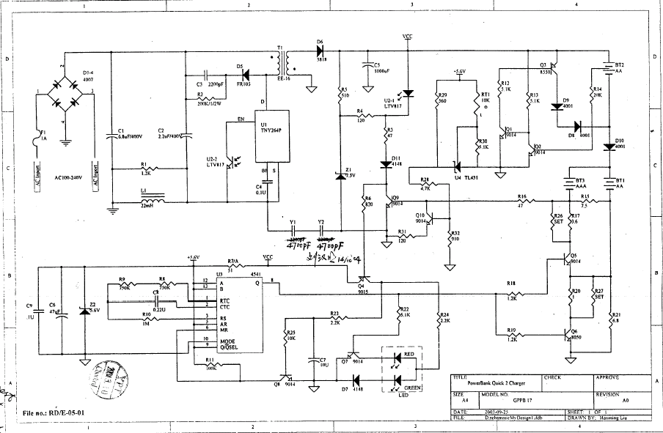
Circuit Diagram 1
Newest circuit

Slide 4
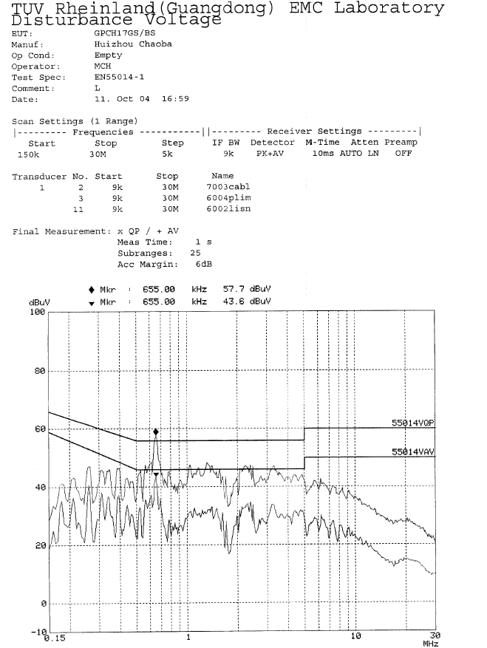
Test condition:
AC 220V/50Hz
Empty
Test result:
Failed
Test data:
0.655MHz
QP:53.6/56 dBuV
AV:43.6/46 dBuV

Slide 5
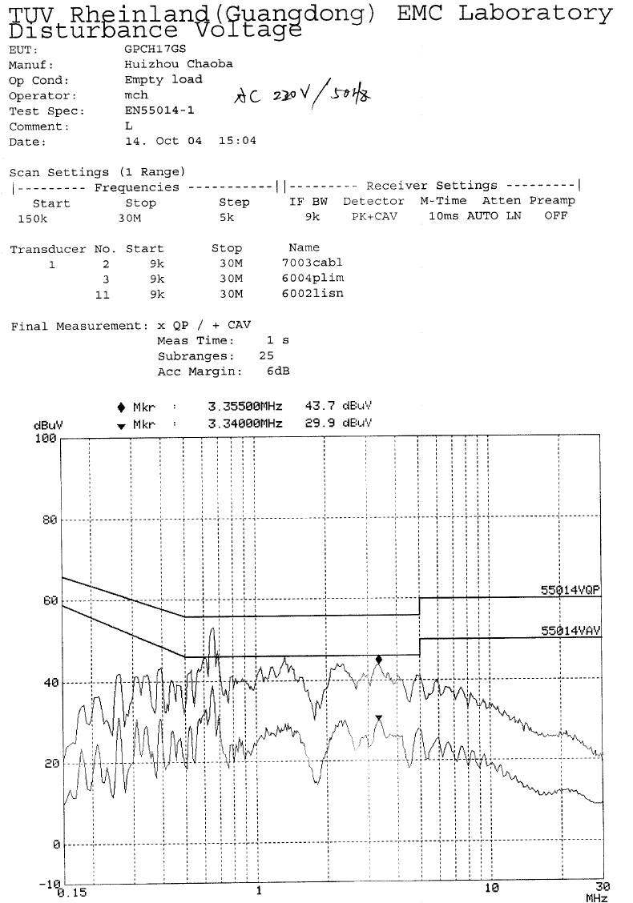
Test condition:
AC 220V/50Hz
Empty
Test result:
ok
Test data:
0.650MHz
QP:49.7/56 dBuV
AV:38.3/46 dBuV

Slide 6
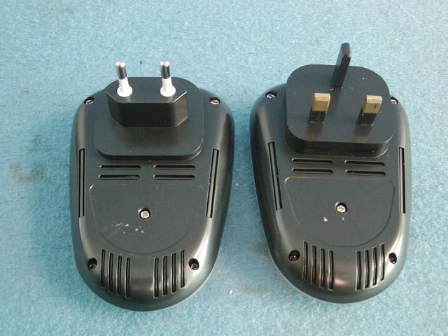
Circuit Diagram 1
ESD failed position

Slide 7
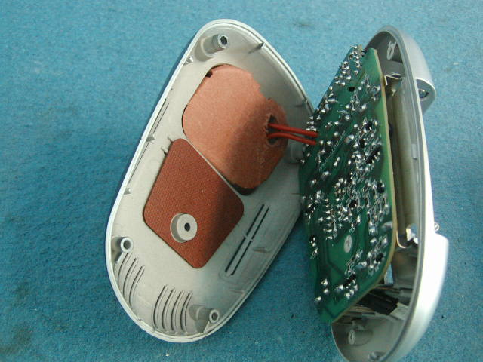
Circuit Diagram 1
ESD modification

Slide 8
Disturbance Source
IC: narrow band disturbance, voltage & power

Slide 9
Sensitive components for immunity test
IC (all)
PCB layout

Slide 10
Applicable standards
EN 55014-1:2000+A1+A2
EN 55014-2:1997+A1
EN 61000-3-2:2000
EN 61000-3-3:1995+A1

Slide 11
Test items/operation modes
Disturbance Voltage: high and low voltage, full load charging and empty
Disturbance Power: high and low voltage, full load and empty
Harmonics: n.a. less than 75W
EMS for Household
For all test items: charging;

